Slide 1


Building Data Platforms
Clemen Kok
Lecture I: Cloud Architecture and Infrastructure-as-Code
CAA 061023

Slide 2

MEng Electronic and Information Engineering
AWS Solutions Architect (Professional) | ex-AWS Intern
whoami

Slide 3
Organisations build their data architecture
in the cloud.

Slide 4

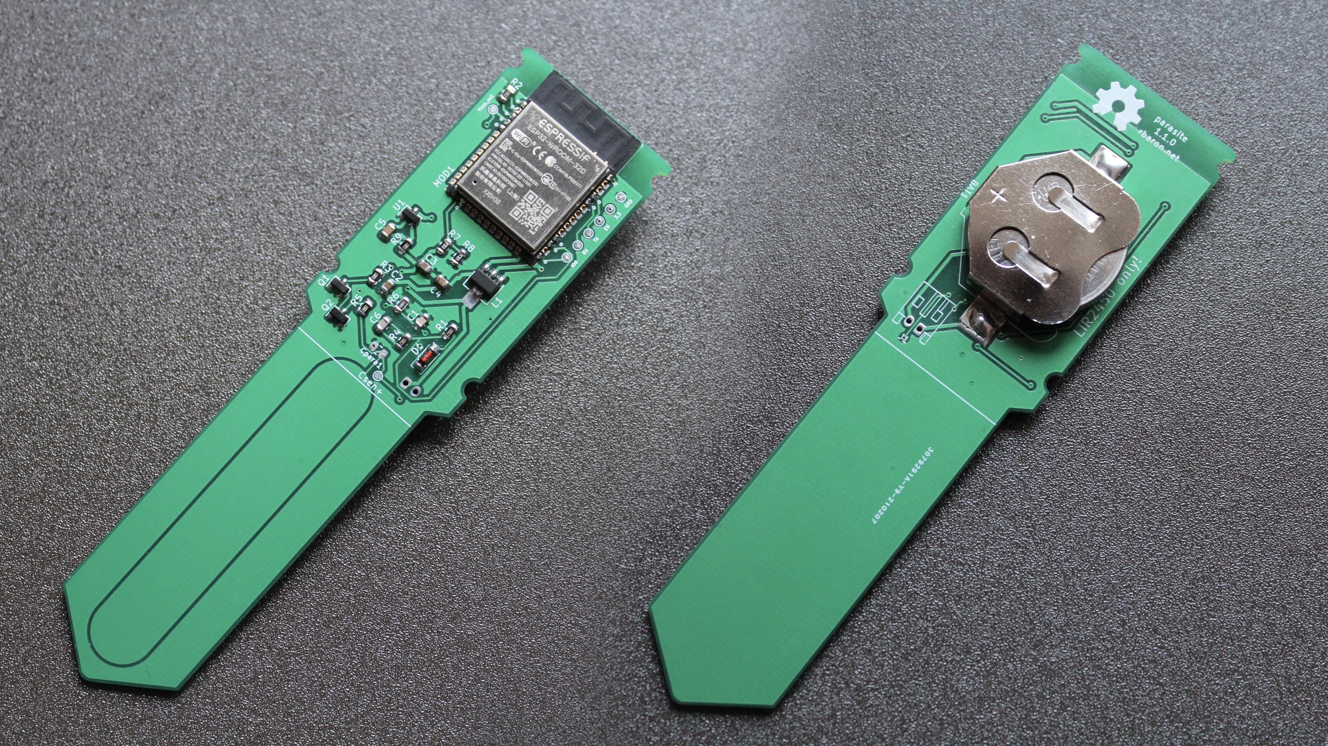

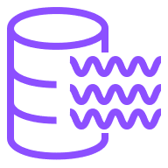
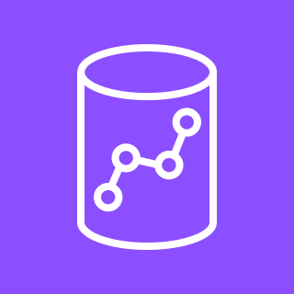





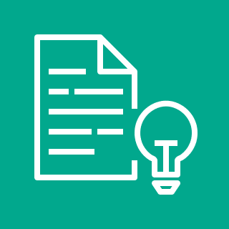

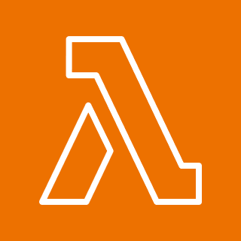



Source Data
Store, Ingest, Backup
Value Layer
Visualise
Amazon S3 Data Lake
Data Lake
Amazon Athena
Interactive Query Service
IoT Device
Raw Data
Transform
Processed
Data
Amazon Redshift Data Warehouse
Social Media
Amazon QuickSight
Data Transformation
Geospatial
Amazon Comprehend (NLP)
AWS Glue
(ETL)
AWS Lambda
(Custom Code)
Amazon CloudWatch
(Metrics)
Amazon SageMaker
ML Platform
End User

Slide 5
Source Data
Store, Ingest, Backup
Value Layer
Visualise
Amazon S3 Data Lake
Data Lake
Amazon Athena
Interactive Query Service
Declaratively
Create Infrastructure
IoT Device
Raw Data
Transform
Processed
Data
Amazon Redshift Data Warehouse
Social Media
Amazon QuickSight
Data Transformation
Geospatial
Amazon Comprehend (NLP)
AWS Glue
(ETL)
AWS Lambda
(Custom Code)
Amazon CloudWatch
(Metrics)
Amazon SageMaker
ML Platform
End User

Slide 6
& Make
Design

Slide 7
& Make
Design

Slide 8

A Simple E-Commerce App

Slide 9



Function putDataInDB(){
// … do something
}
Frontend
Backend
Database
<div>Shoppers.com</div>
<button onClick={e}>Buy</button>
INSERT INTO database
VALUE ;

Slide 10
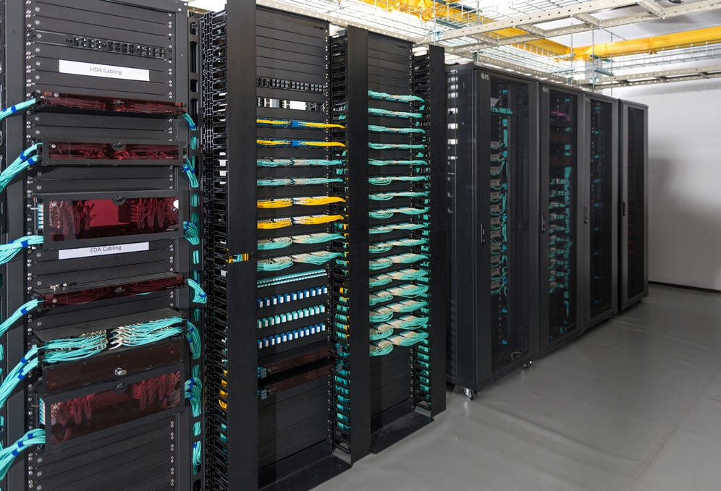

On-Premises Server
New update!

Slide 11

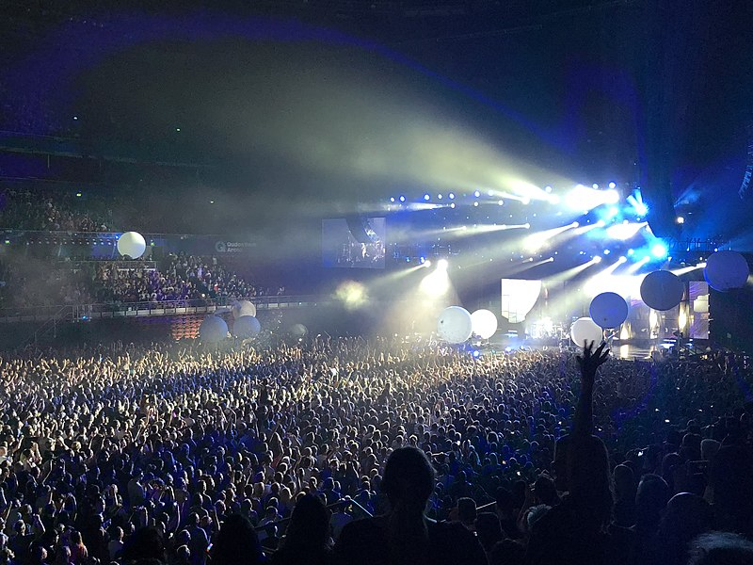
On-Premises Server
Viral

Slide 12


On-Premises Server
Fire

Slide 13
On-Premises Server Rack
High operational overhead to perform software updates and manage configurations.
Self-managed Security, High Availability and Disaster Recovery.
Tough to scale (need to buy new servers).
Frontend
Backend
Database

Slide 14
On-Premises Server Rack
High operational overhead to perform software updates and manage configurations.
Self-managed Security, High Availability and Disaster Recovery.
Tough to scale (need to buy new servers).
Frontend
Backend
Database

Slide 15
On-Premises Server Rack
High operational overhead to perform software updates and manage configurations.
Self-managed Security, High Availability and Disaster Recovery.
Tough to scale (need to buy new servers).
Frontend
Backend
Database

Slide 16
Scalability
Reliability
Security
Observability
Cost
Can my architecture scale up to meet increased demand?

Slide 17
Scalability
Reliability
Security
Observability
Cost
If there’s a fault somewhere, will my services remain available?
If my database goes down, what happens to user data?

Slide 18
Scalability
Reliability
Security
Observability
Cost
Can attackers break into our systems?

Slide 19
Scalability
Reliability
Security
Observability
Cost
If something is wrong, can I see the error logs?
Do I have metrics on my system load?

Slide 20
Scalability
Reliability
Security
Observability
Cost
How much are we going to pay for our services?
Where are we overspending?

Slide 21

Some Key Concepts to Know…
AWS EC2
Compute Instances (Virtual Machines) in the Cloud
Auto-Scaling: Automatically adjust the number of EC2 instances based on traffic load

Slide 22

Some Key Concepts to Know…
Auto Scaling
Predefined Policies – one example is Target Tracking
For example: 70% CPU Utilisation. If this metric (averaged over all instances) deviates, scale-in or scale-out.

Slide 23

Some Key Concepts to Know…
Load Balancing
Distributing incoming network traffic across multiple servers
Round Robin, Least Connections, Least Response Time, Least Outstanding Requests

Slide 24

Some Key Concepts to Know…
Availability Zone
Isolated Data Centers within AWS Regions that provide High Availability and Fault Tolerance

Slide 25
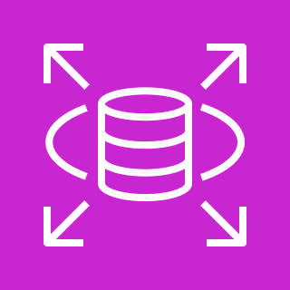
Some Key Concepts to Know…
AWS Relational Database Service
Fully managed database service. Supports multiple DB engines like MySQL and PostgreSQL
AWS handles patching, backups, hardware provisioning

Slide 26


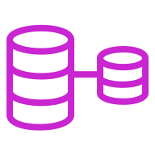
AWS Cloud
Region
AZ 1
AZ 1
AZ 1
Web Server
App Server
Database (Primary)
Load Balancer
AZ 2
Load Balancer
AZ 2
AZ 2
Web Server
App Server
Database (Secondary)
Auto scaling
Auto scaling
Multi-AZ
Migration Architecture
Scalability
Reliability
Security
Observability
Cost
Great, we now have a Load Balancer and ASG, which should allow us to take on greater customer demand.
Can our Database handle an increased load? What can we do about it? What about cold starts?

Slide 27
AWS Cloud
Region
AZ 1
AZ 1
AZ 1
Web Server
App Server
Database (Primary)
Load Balancer
AZ 2
Load Balancer
AZ 2
AZ 2
Web Server
App Server
Database (Secondary)
Auto scaling
Auto scaling
Multi-AZ
Migration Architecture
Scalability
Reliability
Security
Observability
Cost
Our infrastructure is deployed on two AZs. This will protect us against an AZ outage.
Do we have backups of our data in the event of a fault?

Slide 28
AWS Cloud
Region
AZ 1
AZ 1
AZ 1
Web Server
App Server
Database (Primary)
Load Balancer
AZ 2
Load Balancer
AZ 2
AZ 2
Web Server
App Server
Database (Secondary)
Auto scaling
Auto scaling
Multi-AZ
Migration Architecture
Scalability
Reliability
Security
Observability
Cost
What can we do to prevent attackers from taking control of our AWS accounts and infrastructure?
Is our application resilient to DDoS attacks?

Slide 29
AWS Cloud
Region
AZ 1
AZ 1
AZ 1
Web Server
App Server
Database (Primary)
Load Balancer
AZ 2
Load Balancer
AZ 2
AZ 2
Web Server
App Server
Database (Secondary)
Auto scaling
Auto scaling
Multi-AZ
Migration Architecture
Scalability
Reliability
Security
Observability
Cost
Do we have metrics on-hand to tell if our architecture is able to handle demand?
Where are our logs? Are they centralised?

Slide 30
AWS Cloud
Region
AZ 1
AZ 1
AZ 1
Web Server
App Server
Database (Primary)
Load Balancer
AZ 2
Load Balancer
AZ 2
AZ 2
Web Server
App Server
Database (Secondary)
Auto scaling
Auto scaling
Multi-AZ
Migration Architecture
Scalability
Reliability
Security
Observability
Cost
Do our EC2 instances use Spot / On-Demand Instances, which are cheaper, or Reserved Instances (which cost more)?

Slide 31
Design, now Make.
AWS Cloud
Region
AZ 1
AZ 1
AZ 1
Web Server
App Server
Database (Primary)
Load Balancer
AZ 2
Load Balancer
AZ 2
AZ 2
Web Server
App Server
Database (Secondary)
Auto scaling
Auto scaling
Multi-AZ
Migration Architecture

Slide 32
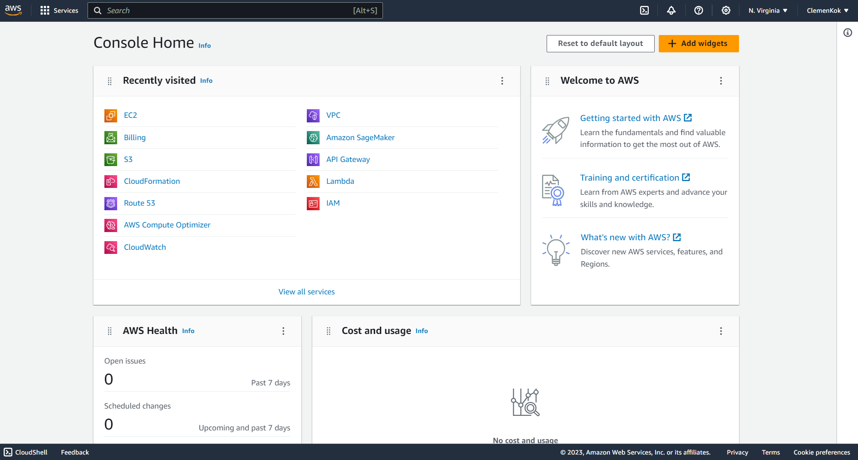
The AWS Console

Slide 33
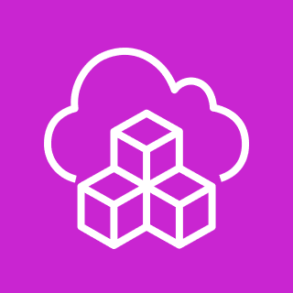
Some Key Concepts to Know…
Infrastructure-as-Code
Approach to managing and provisioning infrastructure with code and automation
Provides version control with tools like Git, and ability to roll back if needed
Great reproducibility – ‘it works on my machine’

Slide 34
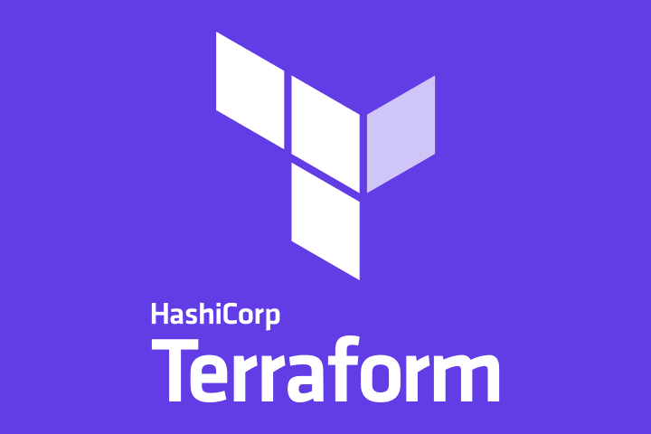
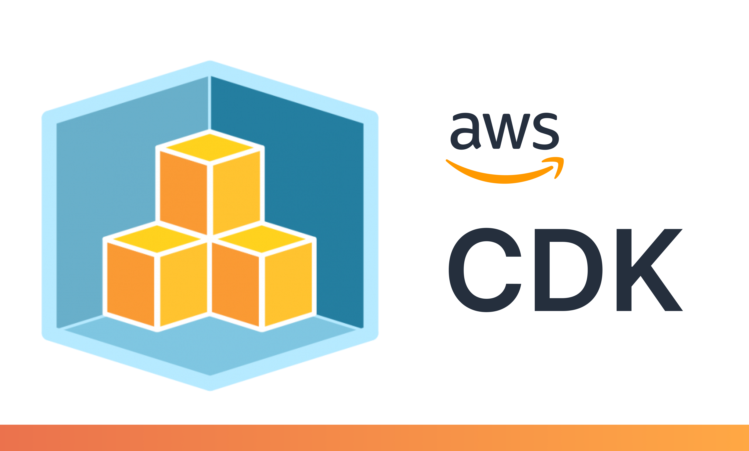
Since we’re mostly using AWS – we’ll stick to CDK
(though Terraform is a pretty good alternative)

Slide 35


Some Key Concepts to Know…
CDK converts familiar programming languages like Python to cloud infrastructure
Improved abstraction, faster development
How does this work under the hood?

Slide 36

Some Key Concepts to Know…
We define constructs and resources in a programming language.
This is then synthesised by CDK, generating CloudFormation templates that describe AWS resources and configurations.

Slide 37
Some Key Concepts to Know…
CDK Constructs
Encode configuration detail, boilerplate and glue logic for one or multiple AWS services
Why build one brick at a time when you can prefabricate components
Customisable, shareable, reusable

Slide 38
Some Key Concepts to Know…
Infrastructure 🤝 Runtime
We can include runtime code assets in the same project as our infrastructure, in the same programming language
Lambda runtime code / Docker container image / React frontend UI in the same repository as our CDK code, in the same language
This is massive

Slide 39

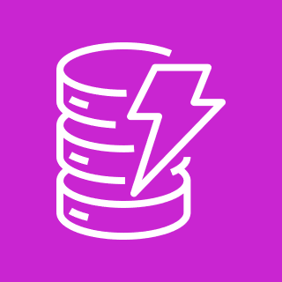
Let’s set up a simple webservice with AWS CDK in Python
Amazon API Gateway
AWS Lambda
Amazon DynamoDB
https://cdkworkshop.com/30-python/30-hello-cdk/200-lambda.html

Slide 40
Some Key Concepts to Know…
Serverless - Lambda
Build and run applications without managing or provisioning servers
Write code and deploy functions – AWS takes care of underlying infrastructure
Runs code (function) in response to events and automatically scales as needed - FaaS

Slide 41
Some Key Concepts to Know…
Serverless – DynamoDB
Serverless NoSQL Database that automatically scales
NoSQL:
No fixed schema (data can be stored in various formats without a predefined table structure)
Horizontal scalability (add more servers / nodes to DB cluster)

Slide 42
Some Key Concepts to Know…
Serverless – API Gateway
Fully managed service to create, publish and manage APIs
RESTful APIs / WebSocket APIs / HTTP APIs
REST –Create, Read, Update, Delete resources

Slide 43
Let’s set up a simple webservice with AWS CDK in Python
demo time
https://tinyurl.com/ICDSSDataPlatforms1

Slide 44
See you next week for some data wrangling!
S3, ETL (AWS Glue), Data Warehousing (Amazon Redshift)
date –d “+1 week”

